Slide 1

[+] Green is Good 558ms
[-] Red is Bad 168ms
Turning Your Checklists
into Pester Tests
Rob Sewell @sqldbawithbeard

Slide 2


Slide 3
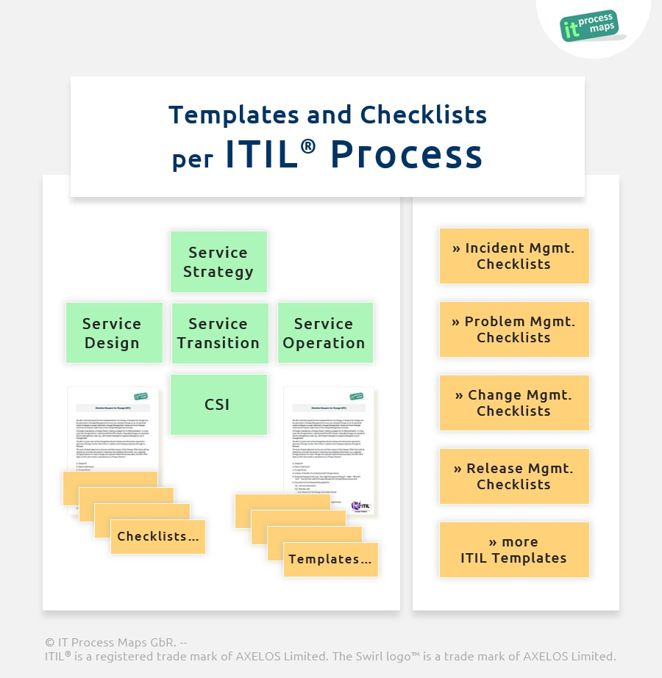
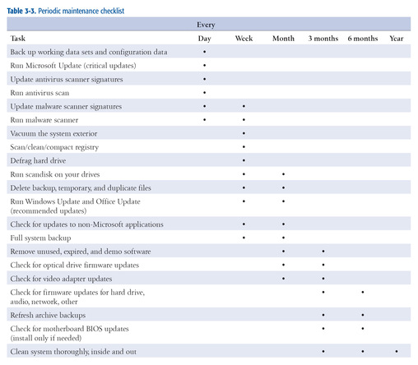
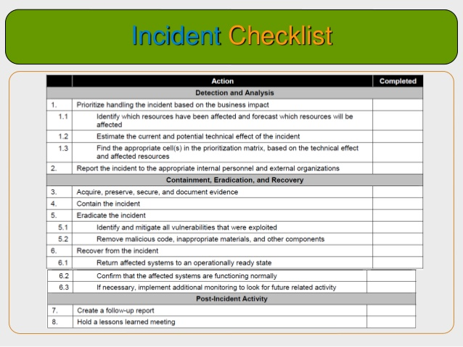
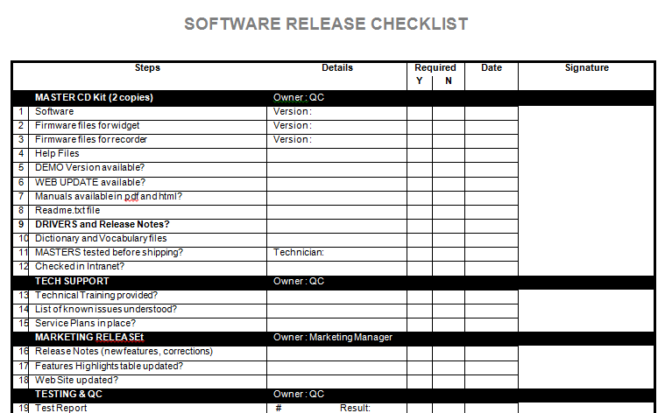
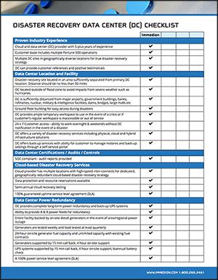
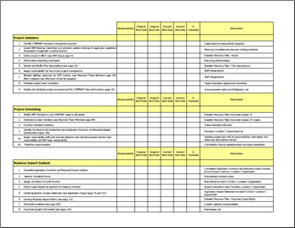
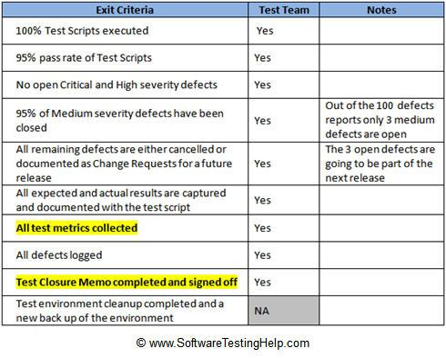
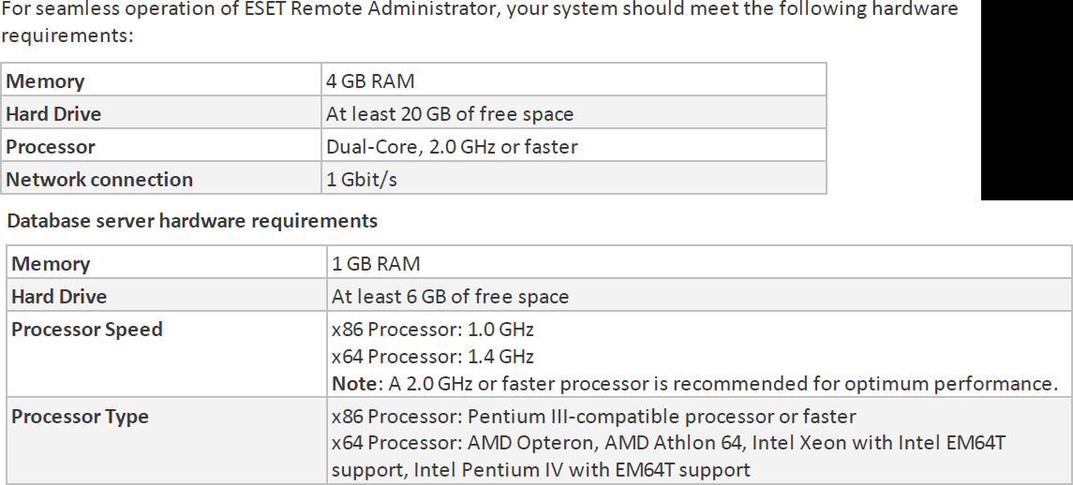
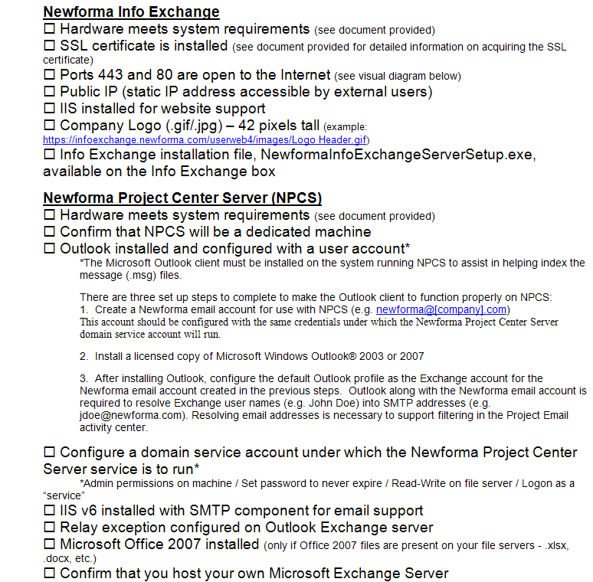
How Many Checklists Do You Have?
Notes:
I bet there are checklists for
New servers/ data centers
Hardware/software installations
Incident Response
1st Line/2nd line for systems
Pre-requisites
Morning routines

Slide 4
What else?
How about Demos
Presentations? – Ask the presenters here if they have used Pester to make sure their demos will work ;-)
I‘m sure you are already thinking of more

Slide 5
What is Pester?
Pester provides a framework for running unit tests to execute and validate PowerShell commands from within PowerShell
https://github.com/pester/Pester
Notes:
Its used for unit testing or TDD but can also be used to validate an environment. Comes with Windows 10 or install from the gallery with Install-Module Pester

Slide 6
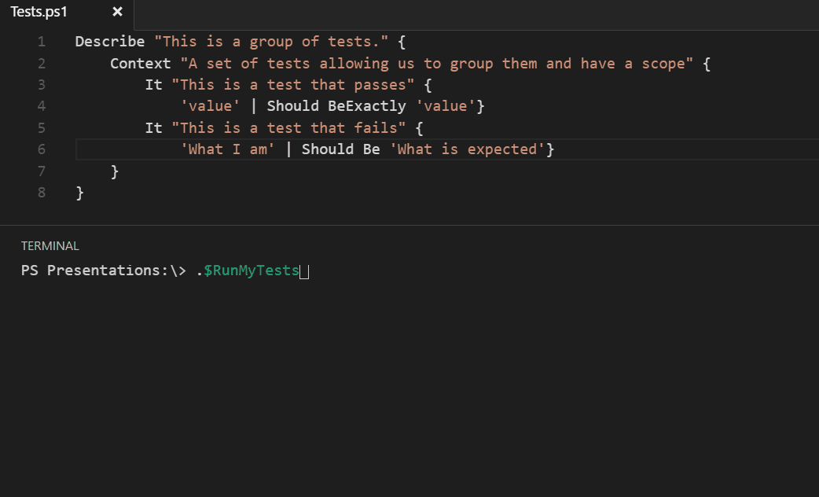
Notes:
This is a Pester test running in VS Code

Slide 7
What is Pester?
Pester provides a framework for running unit tests to execute and validate PowerShell commands from within PowerShell
https://github.com/pester/Pester
Notes:
Its used for unit testing or TDD but can also be used to validate an environment. Comes with Windows 10 or install from the gallery with Install-Module Pester

Slide 8
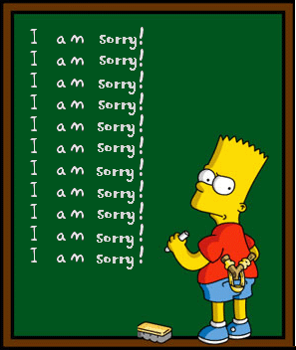
Apologies

Slide 9
Should Operators
Be Compares one object with another for equality. Case Insensitive
BeExactly Compares one object with another for equality . Case Sensitive
BeGreaterThan Asserts that a number is greater than an expected value.
BeLessThan Asserts that a number is less than an expected value.
BeLike Asserts that the actual value matches a wildcard pattern using -like operator. Case Insensitive
BeLikeExactly Asserts that the actual value matches a wildcard pattern using -like operator. Case Sensitive
BeOfType Asserts that the actual value should be an object of a specified type
Exist Does not perform any comparison but checks if the object calling Exist is present in a PS Provider.
Contain Checks to see if a file contains the specified text. Case Insensitive
ContainExactly Checks to see if a file contains the specified text. Case Sensitive
Match Uses a regular expression to compare two objects. Case Insensitive
MatchExactly Uses a regular expression to compare two objects. Case Sensitive
Throw Checks if an exception was thrown in the input ScriptBlock.
BeNullOrEmpty Checks values for null or empty (strings).
I Hate slides with lots of text but I think this one is valid

Slide 10

So What Can You Validate?
Notes:
Everything in the world ☺

Slide 11
Round Up
We all have checklists – manual testing is error-prone
Pester is a Unit Testing Framework for PowerShell
You can use it to validate your infrastructure
The basic syntax uses Describe, Context and It Code blocks
The Should command is used for testing assertions
Use the NunitXML output and the reportviewer.exe to make HTML reports
Rob Sewell @sqldbawithbeard http://sqldbawithAbeard.com

Slide 12
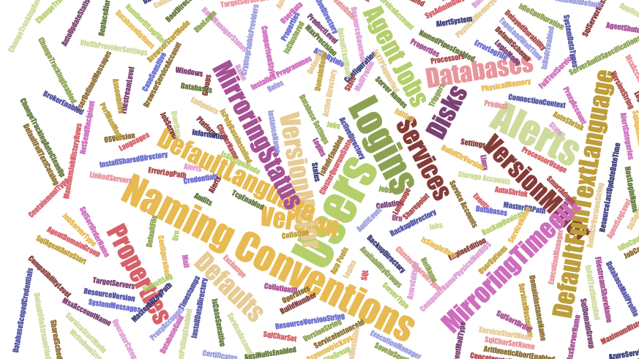
Maybe not EVERY thing but anything you can check with PowerShell
$srv | Get-Member -MemberType Property |Select-Object name
$srv.JobServer | Get-Member -MemberType Property |Select-Object name
$srv.Databases | Get-Member -MemberType Property |Select-Object name
$srv.Configuration | Get-Member -MemberType Property |Select-Object name

Slide 13

MUST BE TIME
FOR A DEMO

Slide 14
Summary
We all have checklists – manual testing is error-prone
Pester is a Unit Testing Framework for PowerShell
You can use it to validate your infrastructure
The basic syntax uses Describe, Context and It Code blocks
The Should command is used for testing assertions
Use the NunitXML output and the reportviewer.exe to make HTML reports

Slide 15
Next Steps...
Now: 15 min break
Grab a coffee
Stay here to enjoy next presentation
Change track and switch to another room
Ask me questions or meet me in a breakout session room afterwards

